Slide 1
Mini project –TIC TAC TOE
By GAURANG GUPTA
(BTECH –CS)
(SECOND YEAR)
(SEC-A)
(1808210053)

Slide 2
CONTENT
Introduction
Header Files and Function Used
Program Explanation

Slide 3
Introduction to tic tac toe
Tic-tac-toe (or Noughts and crosses, Xs and Os) is a pencil and-
paper game for two players, X and O, who take turns
marking the spaces in a 3×3 grid. The player who succeeds in
placing three respective marks in a horizontal, vertical, or
diagonal row wins the game.
This program is a game program, Tic Tac
Toe. Most of us have played this game in
school days, we have make a C
program on it.

Slide 4
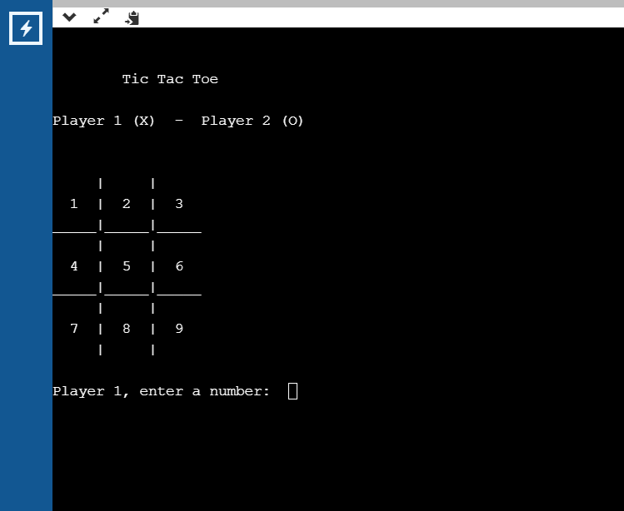
(A sample screen shot)
This game uses board to control players
In each turn players enter a number and
choose a move
Simplify programing assumes that player
one always moves first and uses X's
Player two moves at 2nd position and
uses O's

Slide 5
Headerfiles and functions used
Headerfiles:
#include <stdio.h>
#include<conio.h>
#include <windows.h>
#include <process.h>
functions:
Void gotoxy();
int checkwin();
void board();
system("cls");

Slide 6
#include <stdio.h>
Its a pre processor that we use before writing our main program. This is also called as system library which contains the definition of some pre defined functions. Stdio mean standard input and output.
This system library contains definitions of : printf(), scanf(), puts(), grts(), fgetc(), and many more functions.
If you don't use stdio.h and you use printf() function the compiler will not to be able to get the defination pf printf to perform printing task.

Slide 7
#include<conio.h>
It’s basically used in Turbo C++ IDE. It has two important functions:
clrscr() - This is used to clear the previous output in the output window. If we don’t use it in our program then the output window will become messy.
getch() - This function is used to hold the output window, otherwise when you run your code it will display the output window for just a fraction of second. So, it is necessary to use it, if we want to hold our output screen.

Slide 8
#include<windows.h>
The header file Windows.h, is base header file for Win32 programming, its contain declaration of almost all basic windows macros and different typesdef.
Window.h also contain declaration of from basic windows dll like User32.dll, which contain api’s for accessing heart of Operating system.

Slide 9
#include<process.h>
process.h’ is a header file which includes macros and declarations. These are especially used during work with thread and processes. There is no standard for process.h functions. They depend on compiler which we use.

Slide 10
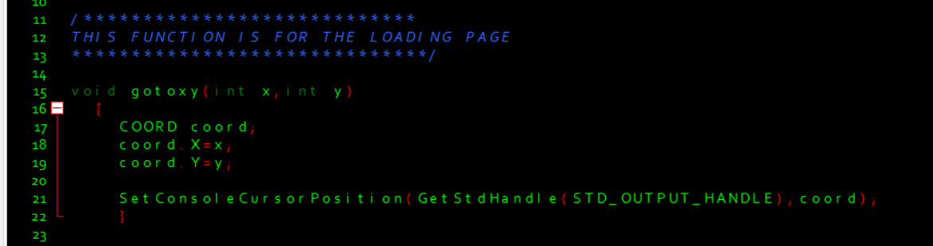
Initialization Of Variables & explanatory statements
This portion of code is for initialization of variables, the variables of squares are initializing with the characters from 1 to 9.
The player turn will be initializing to 1 because since
the player 1 makes the first turn Game over is initialize to true but that does not really
matter for this program because after game loop game check itself for winner.

Slide 11
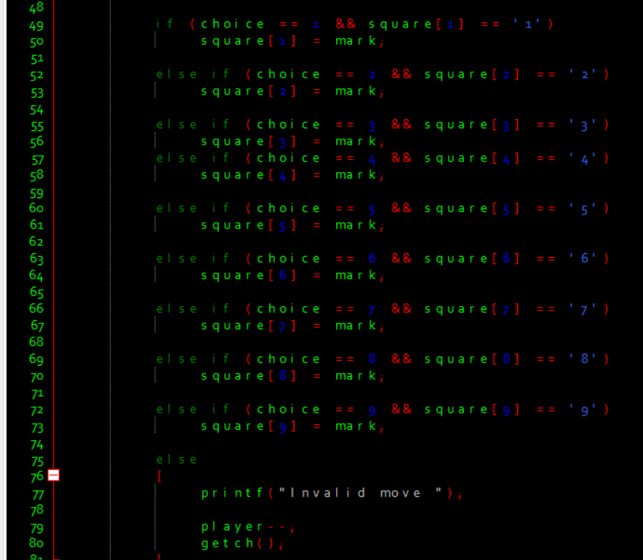
Game loop
After initialization game began to move forward for main game loop these loops are while and do while loop which are encapsulated in statements that what to do or not to do.
Once we enter the game loop The first thing will be done is print the game board which displays the tic tac toe game board in console window Remember we initialize these squares with characters from 1 to 9 for basic console input and output.

Slide 12
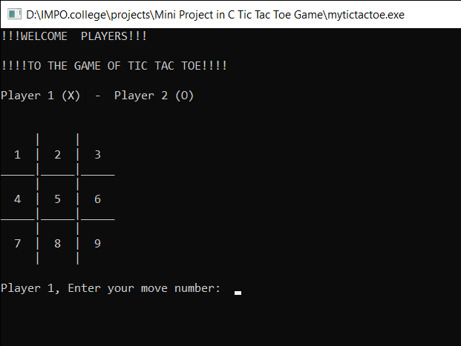
Game loop
(When we run the program the board looks like this)
Notice!! that the console window
prompts the player for move
The player's moves are handled by
the next portion of code

Slide 13
Game Loop( player's moves )
Each branch of the if statement makes two check, the first input check that the input is valid digit from 1 to 9 and second check is for make sure of the input is digit not an character, second check also make sure that the number which is entered not entered Previously once a player moves the square changes like this.

Slide 14
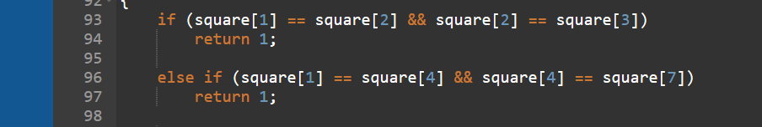
Game Loop( player's moves )
After the valid move the series of checks perform to check
the games conditions.
Note there are the nine ways to end the game, 8 conditions
to win the game and 1 condition for draw the game.
The first conditions check the ending game condition through
the walls of 1st square.

Slide 15
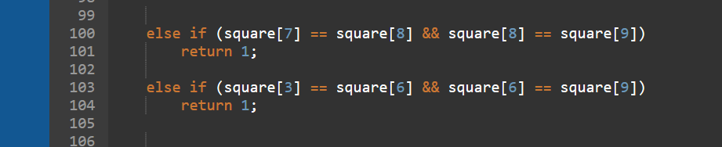
Game Loop( player's moves )
if statement handles the 2 cases from the 9th square

Slide 16
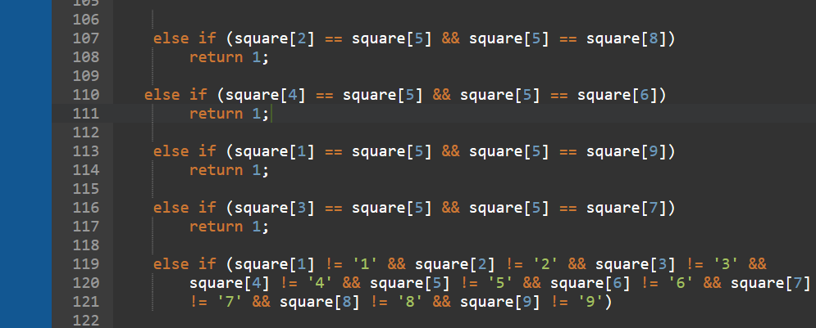
Game Loop( player's moves )
if statement handles the 4 cases from the middle 5th square

Slide 17
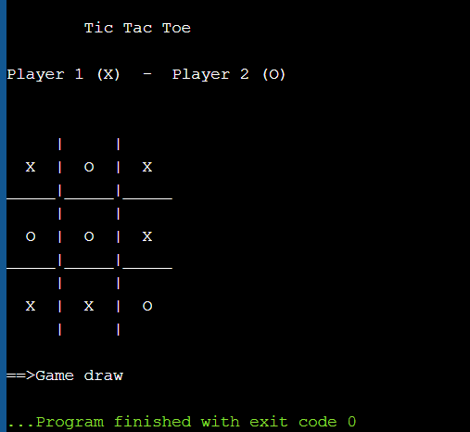
Game Loop( player's moves )
In each of these cases we check that the squares not equals to its number character.
This check ensures that we have an extra O and the other two checks make sure that the other two squares have the same O in the series like this one
Those cases cover the win condition however game will be ended and draw like this.

Slide 18
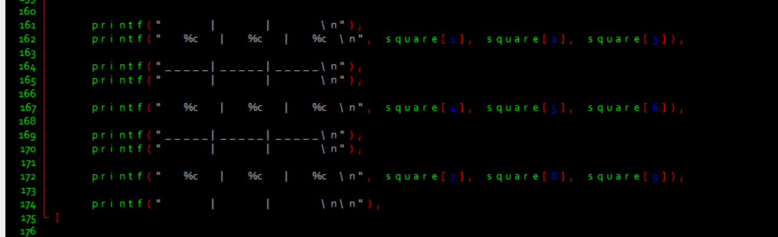
Game Loops (Final Check)
After that we print the ending board of the game.

Slide 19
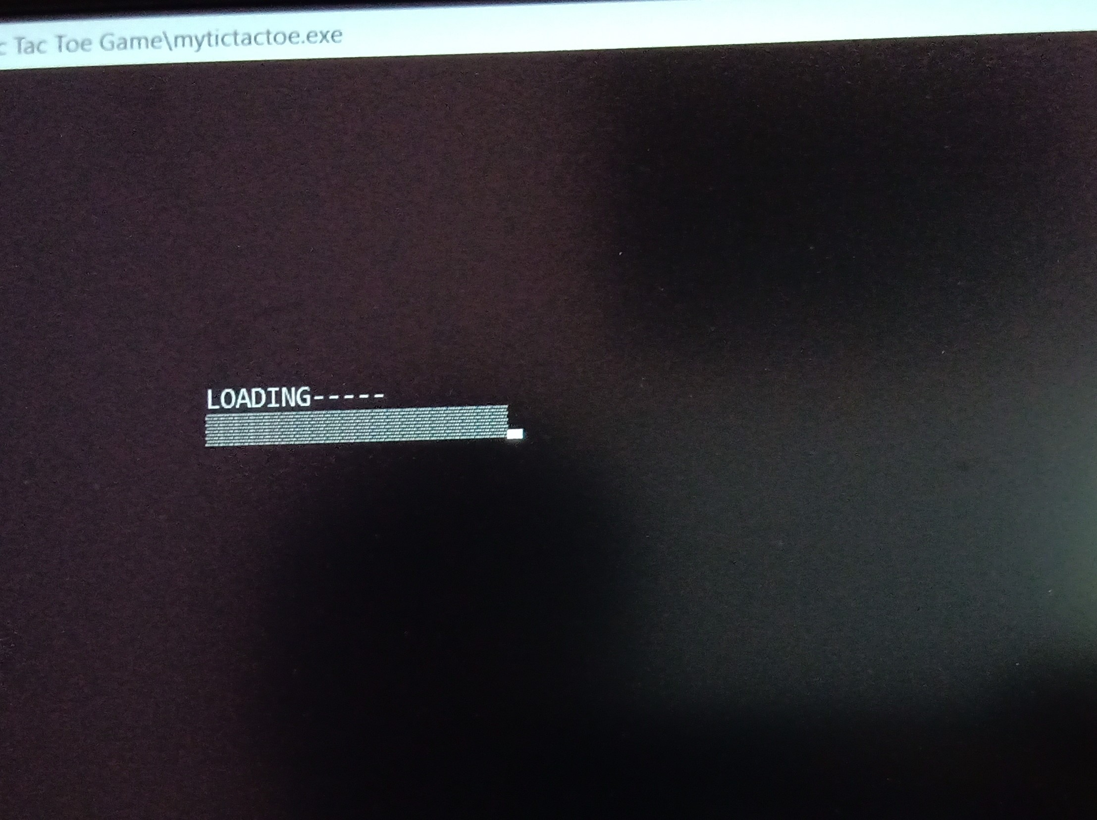
Final screenshots

Slide 20
Thank you

